Slide 1
University of Basrah Al-zahraa medical college
Ministry of higher Education and Scientific Researches
The module:
Molecular, Gene and Diseases
Session 2 Lecture 4
Oxygen Transport Proteins
Duration: 1 h.
Module staff:
Dr. Ihsan M. Humod
Dr. Hussain K. Abdul-Sada
Dr. Nibras S. Al-Ammar
Dr. Wamedh H. Alqatrani
Dr. Ilham Mahammed
Dr. Sadiq Ali
Marks’ Basic Medical Biochemistry Chapter 7
Medical Biochemistry Chapters 2, 5
Lippincott’s Illustrated Reviews: Biochemistry Chapters 2&3
For more detailed instruction, any question, cases need help please post to the group of session.

Slide 2
Intended learning outcomes of this lecture:
Explain the physiological roles of myoglobin and haemoglobin.(LO 2.4)
Contrast the oxygen-binding properties of myoglobin and haemoglobin and explain why haemoglobin is most suited to its role as an oxygen transporter.(LO 2.5)
Describe the major structural differences between oxygenated and deoxygenated haemoglobin and the molecular basis of cooperativity.(LO 2.6)
Describe the effects of CO₂, H⁺, 2’3 bisphosphoglycerate and carbon monoxide on the binding of oxygen by haemoglobin, and the physiological significance of these effects.(LO 2.7)
Appreciate that mutations in globin genes can give rise to diseases such as sickle cell anaemia or thalassemia.(LO 2.8)

Slide 3
It is Important to know that:
Ligand (L): binding molecule to a protein
Binding site: site of a protein that a ligand binds, mostly they are specific
Proteins are flexible: changing in conformation.
induced fit: ligand result in a conformational change on protein’s binding site so it fits the binding site more tightly.
Interactions may be regulated.

Slide 4
LO4
O₂ Essential for cellular respiration
O₂ is poorly soluble in plasma
Impossible to transport by simple diffusion
Only metals: iron, copper
O₂ is transported using two proteins (haemoglobin and myoglobin) That contains essential prosthetic group (heme: contains Fe atom)

Slide 5
Myoglobin and Haemoglobin
LO4
Myoglobin
Single polypeptide chain (153 residue).
3D tertiary structure is similar to both α & β
In heart and skeletal muscle
Function both as a reservoir for O₂ and to transport it with in the muscle cells.
Haemoglobin
Four heteromeric polypeptide chains (4 subunits), in HbA (Adult haemoglobin) 2α chain (141 residue each), and 2β chain (146 residue each).
3D structure of α & β
Found in Red Blood Cells
Function to transport O₂ from the lungs to the capillaries of the tissues. It transports H+ and CO2 too
-The polypeptide chain of myoglobin is structurally similar to the individual subunit
of polypeptide of haemoglobin molecule.
-This homology makes myoglobin a useful model for interpreting some of the more complex properties of haemoglobin.

Slide 6
LO 4&5
Heme
Fe atom binds to the 4 N atoms of the protoporphyrin ring.
The Fe can form 2 additional bonds, one on either side of the plane.
Fe⁺² state binds the oxygen
Fe⁺³ (methaemoglobin) can not bind Oxygen

Slide 7
Fe binding to Histidine and Oxygen
LO 4&5
Fe binds to 4 N atoms of the protoporphyrin ring & two additional bonds one to N of proximal histidine of F helix, another is to O₂

Slide 8
LO 4&5
80% of polypeptide chain folded into eight stretches of α- helix, labeled A, B,C, D, E, F, G, and H.
Internal residues are non-polar, except for two His residues which are involved in O₂-binding.

Slide 9
LO 4&5
Histidine F8 (proximal His) is directly linked to Fe+2.
O₂ is bound directly only to Fe in heme, on the opposite side to His F8
Histidine E7 (distal His) does not directly interact with the heme group, but helps stabilize the binding of Oxygen to the ferrous ion.

Slide 10
Myoglobin and Haemoglobin binding to Oxygen
LO 5
Haemoglobin (Hb) subunits and myoglobin are similar in structure and in heme binding pocket.
Tetrameric haemoglobin molecule is structurally and functionally more complex than myoglobin.
Haemoglobin (Hb) is a dimer of dimers, in which two αβ halves of the heterotetramer are held together at their interface by noncovalent interactions.
The Hb can carry 4 O₂ from lungs to the cells of the body, It also can transport H⁺ and CO₂ from the tissues to the lung.
The oxygen-binding properties of Hb are regulated by interaction with allosteric effectors.

Slide 11
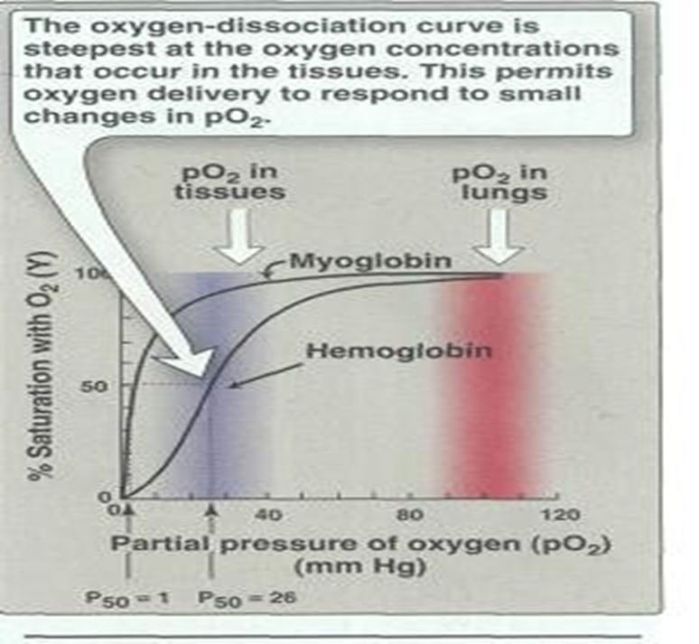
LO 5&6
Oxygen Dissociation Curves for myoglobin and haemoglobin
The degree of saturation(Y) of O₂ binding sites on all myoglobin or haemoglobin molecules can vary between zero (all sites are empty) and 100% (all sites are full).
A plot of Y measured at different partial pressures of O₂ is called Oxygen Dissociation Curve.
P50 Expresses the Relative Affinities of Haemoglobin and myoglobin for Oxygen

Slide 12
LO6
Oxygen Dissociation Curves for myoglobin and haemoglobin important differences
Myoglobin has a higher oxygen affinity than does haemoglobin.
The partial pressure of oxygen needed to achieve half-saturation of the binding sites (P₅₀) is approximately 1mmHg for myoglobin and 26mmHg for haemoglobin.

Slide 13
LO6
Oxygen Dissociation Curves for myoglobin and haemoglobin important differences
The higher the oxygen affinity (that is the more tightly oxygen binds), the lower the P₅₀
A hyperbolic relationship between Y and pO₂ for myoglobin.
A sigmoidal relationship between Y and pO₂ for Hb (cooperative).

Slide 14
LO6
Oxygen Dissociation Curves for myoglobin and haemoglobin important differences
The affinity of haemoglobin for the last oxygen bound is approximately 300 times greater than its affinity for the first oxygen bound
O2 bind to one subunit Affinity of other subunits increase

Slide 15
LO5&6

Slide 16
LO5&6
Conformational Change Of Haemoglobin From T To R State When Oxygen is Bound
On binding oxygen, one pair of αβ -subunits shifts with respect to the other by a rotation of 15 degrees.
Binding of oxygen to one subunit ‘switches’ other subunits to a conformation which favours oxygen binding leading to ‘cooperative’ binding of oxygen.

Slide 17
Position of Fe in myoglobin.
The Fe lies slightly out of the plane of the porphyrin ring, towards His F8.
LO4,5,6
O ₂-binding to Fe pulls the iron into the plane of the ring with associated movement
-The movement of the iron atom during oxygenation brings the iron-associated His residue towards the porphyrin ring. The associated movement of the His-containing a helix alters the interface between the alpha-beta pairs and initiates other structural changes involving other subunits.

Slide 18
LO7
Allosteric effects
The ability o f haemoglobin to reversibly bind oxygen is affected by the following parameters:
pH
pO2
pCO2
the availability o f 2,3-bisphosphoglycerate (BPG).
- These are collectively called allosteric ("other site") effectors, because their interaction at one site on the haemoglobin molecule affects the binding of oxygen to heme groups at other locations on the molecule.

Slide 19
LO7
Regulation of oxygen binding
The highly anionic 2,3-BPG is present in red blood cells at~2 mM. It binds to haemoglobin (one molecule per tetramer) and decreases the affinity for O₂, promoting release in the tissues.
The physiological adaptation to high altitude involves increased tissue concentrations of BPG, leading to more efficient O2 release to compensate for the reduced O2 tension.

Slide 20
LO7
Binding of 2,3-BPG to deoxyhaemoglobin
2,3-BPG binds in the central cavity of the tetramer, interacting with three positively charged on each beta chain.
The oxygenated haemoglobin has a smaller central gap and excludes 2,3-BPG

Slide 21
LO7
Differential oxygen affinity of foetal and maternal red blood cells
Foetal haemoglobin contains a variant of the β chain, called ɤ, which has a His→Ser substitution in the 2,3-BPG-binding site. The foetal haemoglobin thus has a reduced affinity for 2,3-BPG, resulting in an enhanced O₂-binding affinity that allows transfer of O₂ from the maternal to the foetal red blood cells

Slide 22
The Bohr effect
H⁺ ions and CO₂ promote the release of O₂
LO7
Rapidly metabolising tissues, such as contracting muscle, have a high need for O₂ and generate large amounts of H⁺ and CO₂. Both of these species interact with haemoglobin to promote O₂-release.
The O₂ affinity decreases as the pH decreases from the pH 7.4 found in the lungs

Slide 23
The Bohr effect
H⁺ ions and CO₂ promote the release of O₂
LO7
Increased CO₂ concentrations also lead to a decrease in O₂ - affinity.
This regulation of O₂ -affinity by pH and CO₂ is called the Bohr effect after its discoverer, Christian Bohr (1904).
Factors Enhance Unloading of Oxygen at the Tissue and Shift Curve to the Right Include:
-High H+
-High CO2
-High Temp
-High Altitude

Slide 24
LO7
Binding of Carbon monoxide to haemoglobin
Carbon monoxide is toxic even at low concentration
binds tightly (but reversibly) to the Hb iron forming carboxyhaemoglobin.
Affinity of Hb for CO is 220 times greater than for O2.
Treated by 100% oxygen therapy
In anaemia, the curve is still segmoidal, but the saturation is reduced.

Slide 25
LO8

Slide 26
LO8

Slide 27
Which variables increase sickling?
Any variable that increase HbS Deoxy state
O₂ ↓
CO2 ↑
pH ↓
Dehydration
BPG ↑

Slide 28
Questions
A 14-year-old girl was admitted to a children’s hospital in coma. Her mother stated that several days before admission the girl began to complain of thirst and also started to get up several times during the night to urinate. She diagnosed as Diabetic keto acidosis (DKA).
Predict the effect of DKA on the patient's oxygen dissociation curve (ODC).
Briefly explain the molecular bases of such change in (ODC).
Suppose this girl has sickle cell anaemia, how can the DKA affect her haemoglobin structure?
Will this relief or amplify her illness? Why?

Slide 29
Thank you

